Slide 1
Lecture 1
Introduction

Slide 2
What is machine learning?
The key idea is to learn from past experience, similar as humans learn new skills
A formal definition was suggested by Tom Mitchell in 1998: Machine Learning is the study of algorithms that
improve their performance P
at some task T
based on some experience E
Notes:
In this lesson we are going to discuss a totally different approach of numerical algorithms than we did up to now.
We want to give a very brief introduction to the waste domain of machine learning
The key idea behind machine learning algorithms is to learn from past experience, similar as humans learn new skills
In 1998, a formal definition was suggested by Tom Mitchell
According Mitchell, Machine Learning is the study of algorithms that
- improve their performance P
- at some task T
- based on some experience E

Slide 3
What is machine learning?
Traditional numerical algorithm
Data
Computer
Output
Algorithm
Machine learning
Data
Computer
Algorithm
Output
Notes:
Let us compare traditional numerical algorithms, such as we have seen so far, with machine learning approach
In the algorithms we discussed so far we had some data as input
For example, a data set as we used it in regression, or the data defining an equation to be solved
We further had the algorithm. For example Newton’s algorithm to solve none linear equations
We did then program the algorithm, fed it with the needed data, and finally run it on a computer
The output we got was an approximation of the mathematical problem we aim to solve
In machine learning the approach is different
To start with we have some data and the corresponding output
For example the height and weight of children at different ages
We feed then these data and output to a machine learning framework and the output will be, to some extend, an algorithm able to predict, given that data, the corresponding output
In summary we can say that the main difference between the algorithms we discussed so far and machine learning algorithms is that the first ones give as output the approximation of a mathematical problem whereas the second one give as output an algorithm that will solve the problem we want to handle

Slide 4
Some examples
Improve on task T, with respect to performance metric P, based on experience E
T: Recognizing hand-written digits
P: Percentage of digits correctly classified
E: Database of human-labeled images of hand written digits
T: Driving on highways using vision sensors
P: Average distance traveled before a human-judged error
E: A sequence of images and steering commands recorded while observing human drivers
T: Categorize email messages as spam or legitimate
P: Percentage of email messages correctly classified
E: Database of emails, some with human-given labels
Notes:
Now we understand that main difference between machine learning and traditional numerical algorithms let us give some examples of problems that machine learning is able to handle
We give these example keeping in mind the definition from Tom Mitchell : improve a task T with respect to a performance metric P, based on some experience E
The first example is the recognition of hand-written digits
The task T is to recognize hand-written digits
The performance measure P is the percentage of digits correctly classified
And the experience E we base our learning on is a database of human-labeled images of hand written digits
A second example is the development of algorithms for autonomous cars
The task T is to drive on highways using vision sensors
The performance measure P is the average distance traveled before a human-judged error
And the experience E we base our learning on is a sequence of images and steering commands recorded while observing human drivers
As last example let us consider a spam filter
The task T is categorize email messages as spam or legitimate
The performance measure P is the percentage of email messages correctly classified
And the experience E we base our learning on is a database of emails, some with human-given labels

Slide 5
Two large classes of learning algorithms
Supervised learning
Given: training data + desired outputs (labels)
Unsupervised learning
Given: training data (without desired outputs)
Notes:
Broadly speaking machine learning can be classified in two broad classes :
Supervised learning and unsupervised learning
In supervised learning the machine learning algorithm is provided with data and the desired outputs. These outputs are usually called labels.
For example one provides a set of email messages that are labeled as spam or legitimate massages
In unsupervised learning one provides only the data but not the corresponding labels.
The machine learning algorithm will try to figure out itself the existing categories
In this semester we are only going to discuss some simple examples of supervised learning approaches
An example is face recognition based on a set of images
The algorithm will first identify how many different people are availed and then put all images of a same person in one category

Slide 6


Supervised learning
A typical example of supervised learning is linear regression
Given some data, learn a function f(x) to predict y given x
Here y is a number
Given some data, learn a function f(x) to predict if x belongs to a category
Here y is a Boolean value (T/F)
$$y=f\left(x;a_{0},a_{1},…,a_{p}\right)$$
$$y=f\left(x;a_{0},a_{1},…,a_{p}\right)$$
$$y_{i}$$
Spam
Not a spam
$$x_{i}$$
Email content
Notes:
A typical example of supervised learning is linear regression
Indeed, in linear regression we have a data set and corresponding labels, the y values.
The aim is then to learn a function that represents as good as possible this data set and corresponding labels
Linear regression does this by adjusting the model parameters
In the context of machine learning one says that the algorithm learns the model parameters
Note that in regression the labels don’t necessarily have to be numbers
They can be as well for example Boolean values
An example is the spam filter
Here the data set is a collection of email messages
The labels are Boolean values where for example TRUE stays for a spam message and FALSE for a legitimate message
The task will be to learn the model parameters of a model able to predict if a message is a spam or not
In this lesson on machine learning we are going to discuss both cases: labels being numbers and labels being Boolean values

Slide 7
Sample problem
Recognizing hand-written digits
Human
This is the digit ‘9’
Notes:
The problem we aim to be able to solve at the end of this lesson is the problem of hand written digit recognition
In other words we want to train an algorithm such that it does the same as a human: it will associate to the picture displayed the numerical value ‘9’.
In fact we will deal with a slightly simpler problem and train an algorithm able to predict if the image corresponds or does not correspond to the digit ‘9’
[Image source: plotted based on an entry inside the MNIST database]

Slide 8
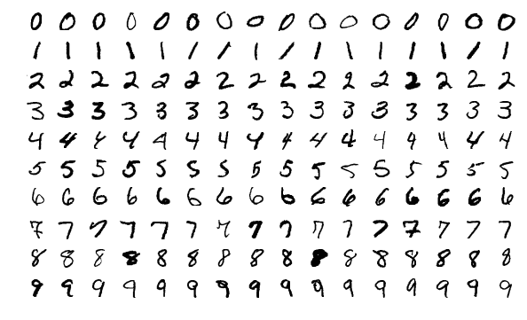
Sample problem
Source: MNIST database
Notes:
For this we will use the so called MNIST database
The MNIST database is a large open-source database of handwritten digits that is commonly used for training various image processing systems
MNIST stands for Modified National Institute of Standards and Technology database
Image source: https://en.wikipedia.org/wiki/MNIST_database

Slide 9
Summary
In machine learning on aims to train an algorithm able to perform some task
Training is done based on past experience
The performance of the trained algorithm is evaluated based on a performance measure
There exist supervised and un-supervised training
An example of supervised learning is regression
Notes:
Let us summarize the key findings
In machine learning on aims to train an algorithm able to perform some task
Training is done based on past experience
The performance of the trained algorithm is evaluated based on a performance measure
There exist supervised and un-supervised training
An example of supervised learning is regression

